Slide 1
Bitcoin: An Overview Eduardo Santos - 93107 Hugo Ferreira - 93093 João Soares - 93078 Pedro Bastos - 93150 Work done under the framework of discipline APSEI of the course Engenharia Informática Department of Electronics, Telecommunications and Informatics University of Aveiro Supervision: Manuel de Oliveira Duarte Date 25/05/2021

Slide 2
Objectives
Understand what are Cryptocurrencies
Study Bitcoin and Bitcoin Protocol
Study the Socio-Economic effects of Bitcoin

Slide 3

Definition of Cryptocurrency
To understand what is a cryptocurrency, we first need to understand the concept of money as a form of currency, as well as a medium of exchange of goods and services. For that we will address the different types of money over time:
Commodity Money
Representative Money
Fiat Money
4

Slide 4


Definition of Cryptocurrency Commodity Money
A physical good whose value comes from the resource of which it is made, in other words, that has “intrinsic value” - utilization outside of its use as money
Its underlying value and use ensures that people trust it because it has value in and of itself and so people can trade it freely with the knowledge that someone will accept it
Characteristics:
Durable
Divisible
Easily exchangeable
Rare
Historical examples:
Salt
Tabacco

Slide 5
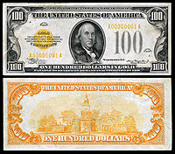
Definition of Cryptocurrency Representative Money
A form of currency often printed on paper that represents something of value -a resource/commodity - but has little or no value of its own
Its acceptance requires that the population trusts the certificate as much as the value that it represents
It was usually backed by a physical resource such as precious metals like gold or silver that existed in the United States as silver certificates or gold certificates issued by State Banks
Nowadays, financial instruments like Checks and Credit Cards are the most common forms of representative money

Slide 6
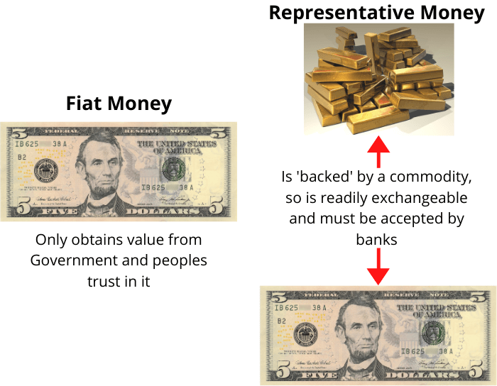

Definition of Cryptocurrency Fiat Money
Today is the most common type of currency
Value is derived by the government and the trust people place in its value
Trust is fundamental because although its value is given by an official law or order, its true value lies in the trust that people place in it
Technically unlimited and cheaper to produce -> Creates Stability

Slide 7
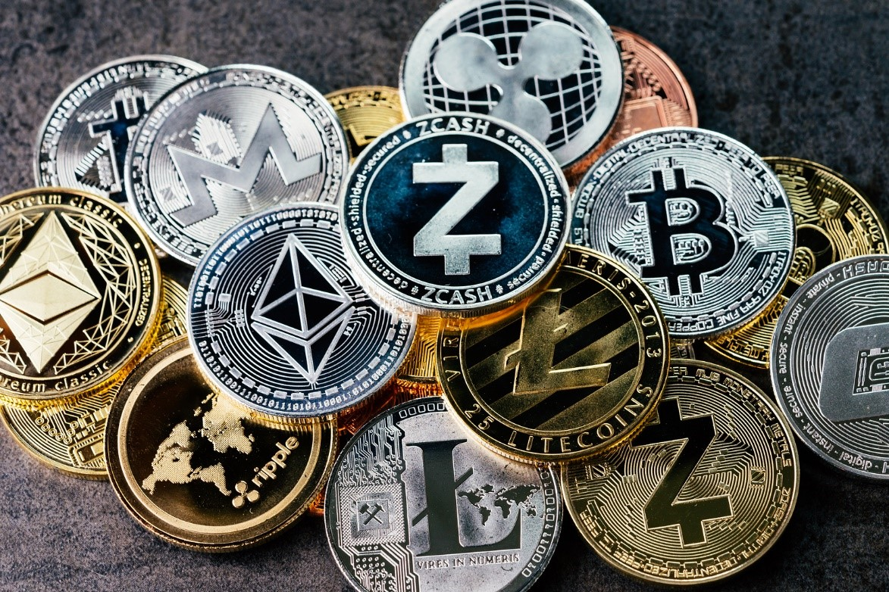
Definition of Cryptocurrency What is Cryptocurrency
A digital currency, in other words, a medium of exchange that is encrypted and decentralized
It doesn't rely on banks to verify transactions, instead it's a peer-to-peer system that can enable anyone anywhere that has a digital wallet, to send and receive payments using a technology called Blockchain
The transactions are recorded in a public ledger
Cryptocurrency got its name because it uses encryption to provide security and safety in transactions

Slide 8
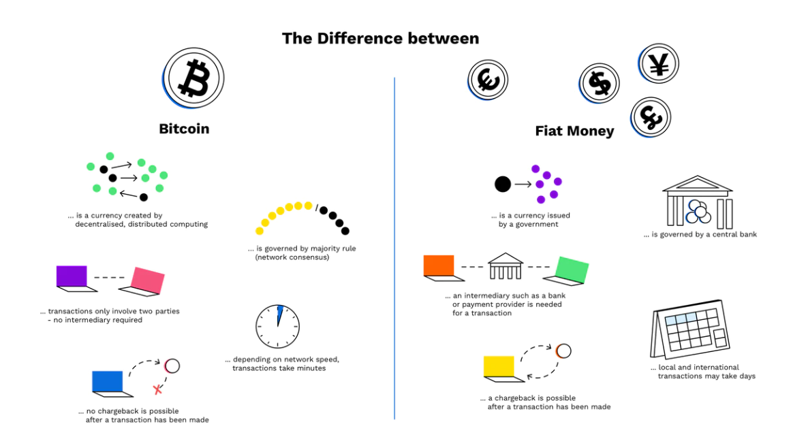
Definition of Cryptocurrency Cryptocurrencies vs Fiat Money
Cryptocurrency is not controlled by a centralized authority, transactions can’t be reversed, cancelled or charged back and while Fiat Money can be physical, cryptocurrency is only digital. Both rely on widespread trust of people in order to function as a means of exchange
Most Cryptocurrencies have a cap which means there is a set number of coins that will ever be in supply, making it possible to tell the amount in circulation at any given time, something impossible in Fiat Money.

Slide 9
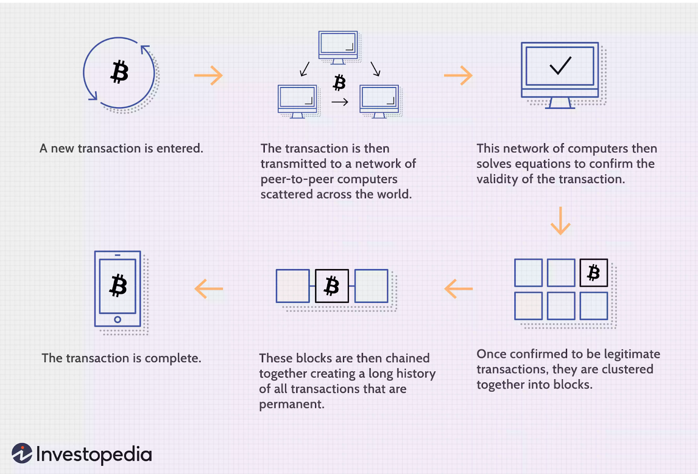
How Cryptocurrency Work
Cryptocurrencies work using a technology called Blockchain. Blockchain is a decentralized technology spread across many computers that manages and records transactions in a way that makes it difficult or impossible to change, hack, or cheat the system, a characteristic that constitutes much of the appeal for this technology.

Slide 10
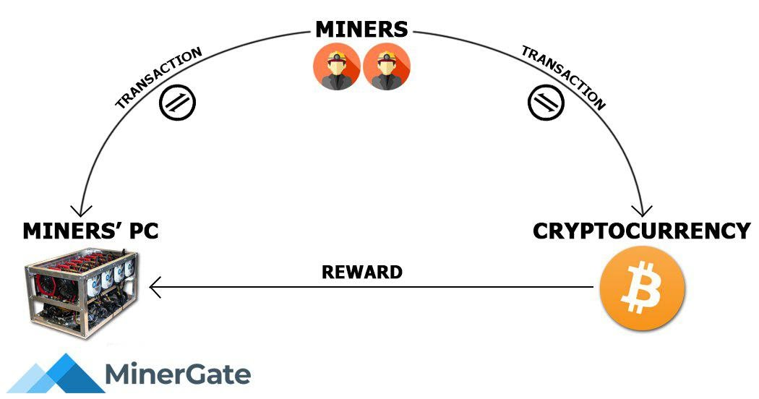
How Cryptocurrency Work
The process by which new currency is produced and entered circulation is designated as Mining
Entire process being conducted by software

Slide 11
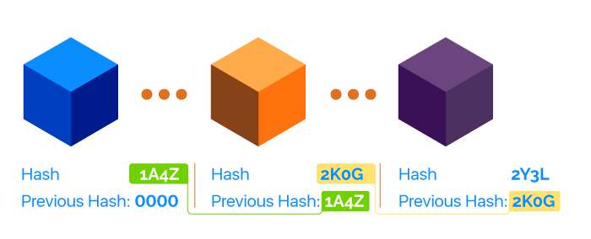
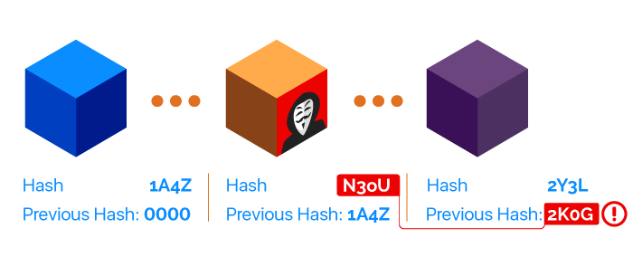
Blockchain What is the blockchain and how does it work
A blockchain is a chain of blocks that contains information. A blockchain is a distributed ledger that is completely open to anyone, and it relies on a key property: when some data is recorded inside a blockchain, it becomes very difficult to change it.

Slide 12
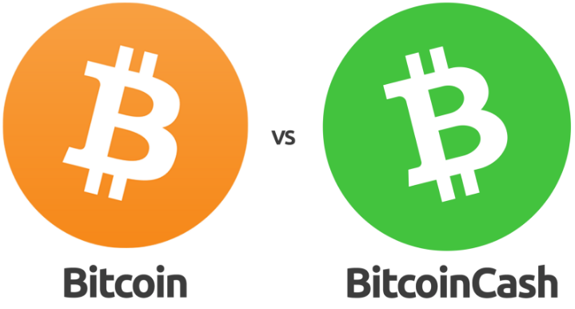
Bitcoin
Bitcoin Cash (BCH)
This was the version that implemented the original planned update. Bitcoin Cash can currently process over one hundred transactions per second, with fees reliably less than a 0.01 USD per transaction.
Bitcoin (BTC)
This version made different updates to the network and kept the original name and symbol. Bitcoin can only process between 3-7 transactions per second. Its fees have ranged anywhere from several cents to tens of dollars per transaction.
12

Slide 13
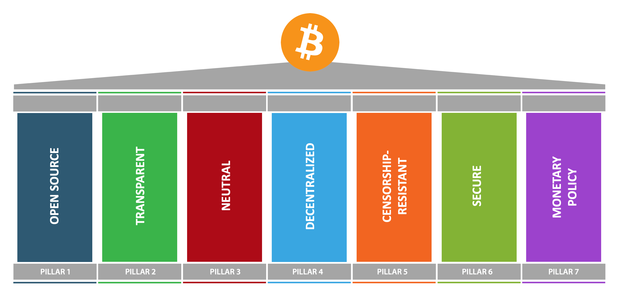
Seven pillars of Bitcoin
13

Slide 14
Bitcoin Protocol
Bitcoins are not stored centrally nor locally, they exist in a distributed ledger called blockchain.
This ledger runs on a P2P network of computers.
This is made possible with the usage of a private key - public key ECDSA pair.
But how does this work?
14

Slide 15
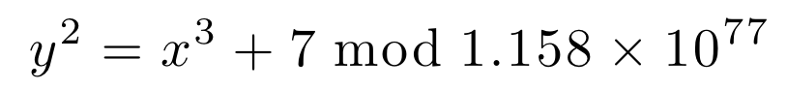

ECDSA
15

Slide 16

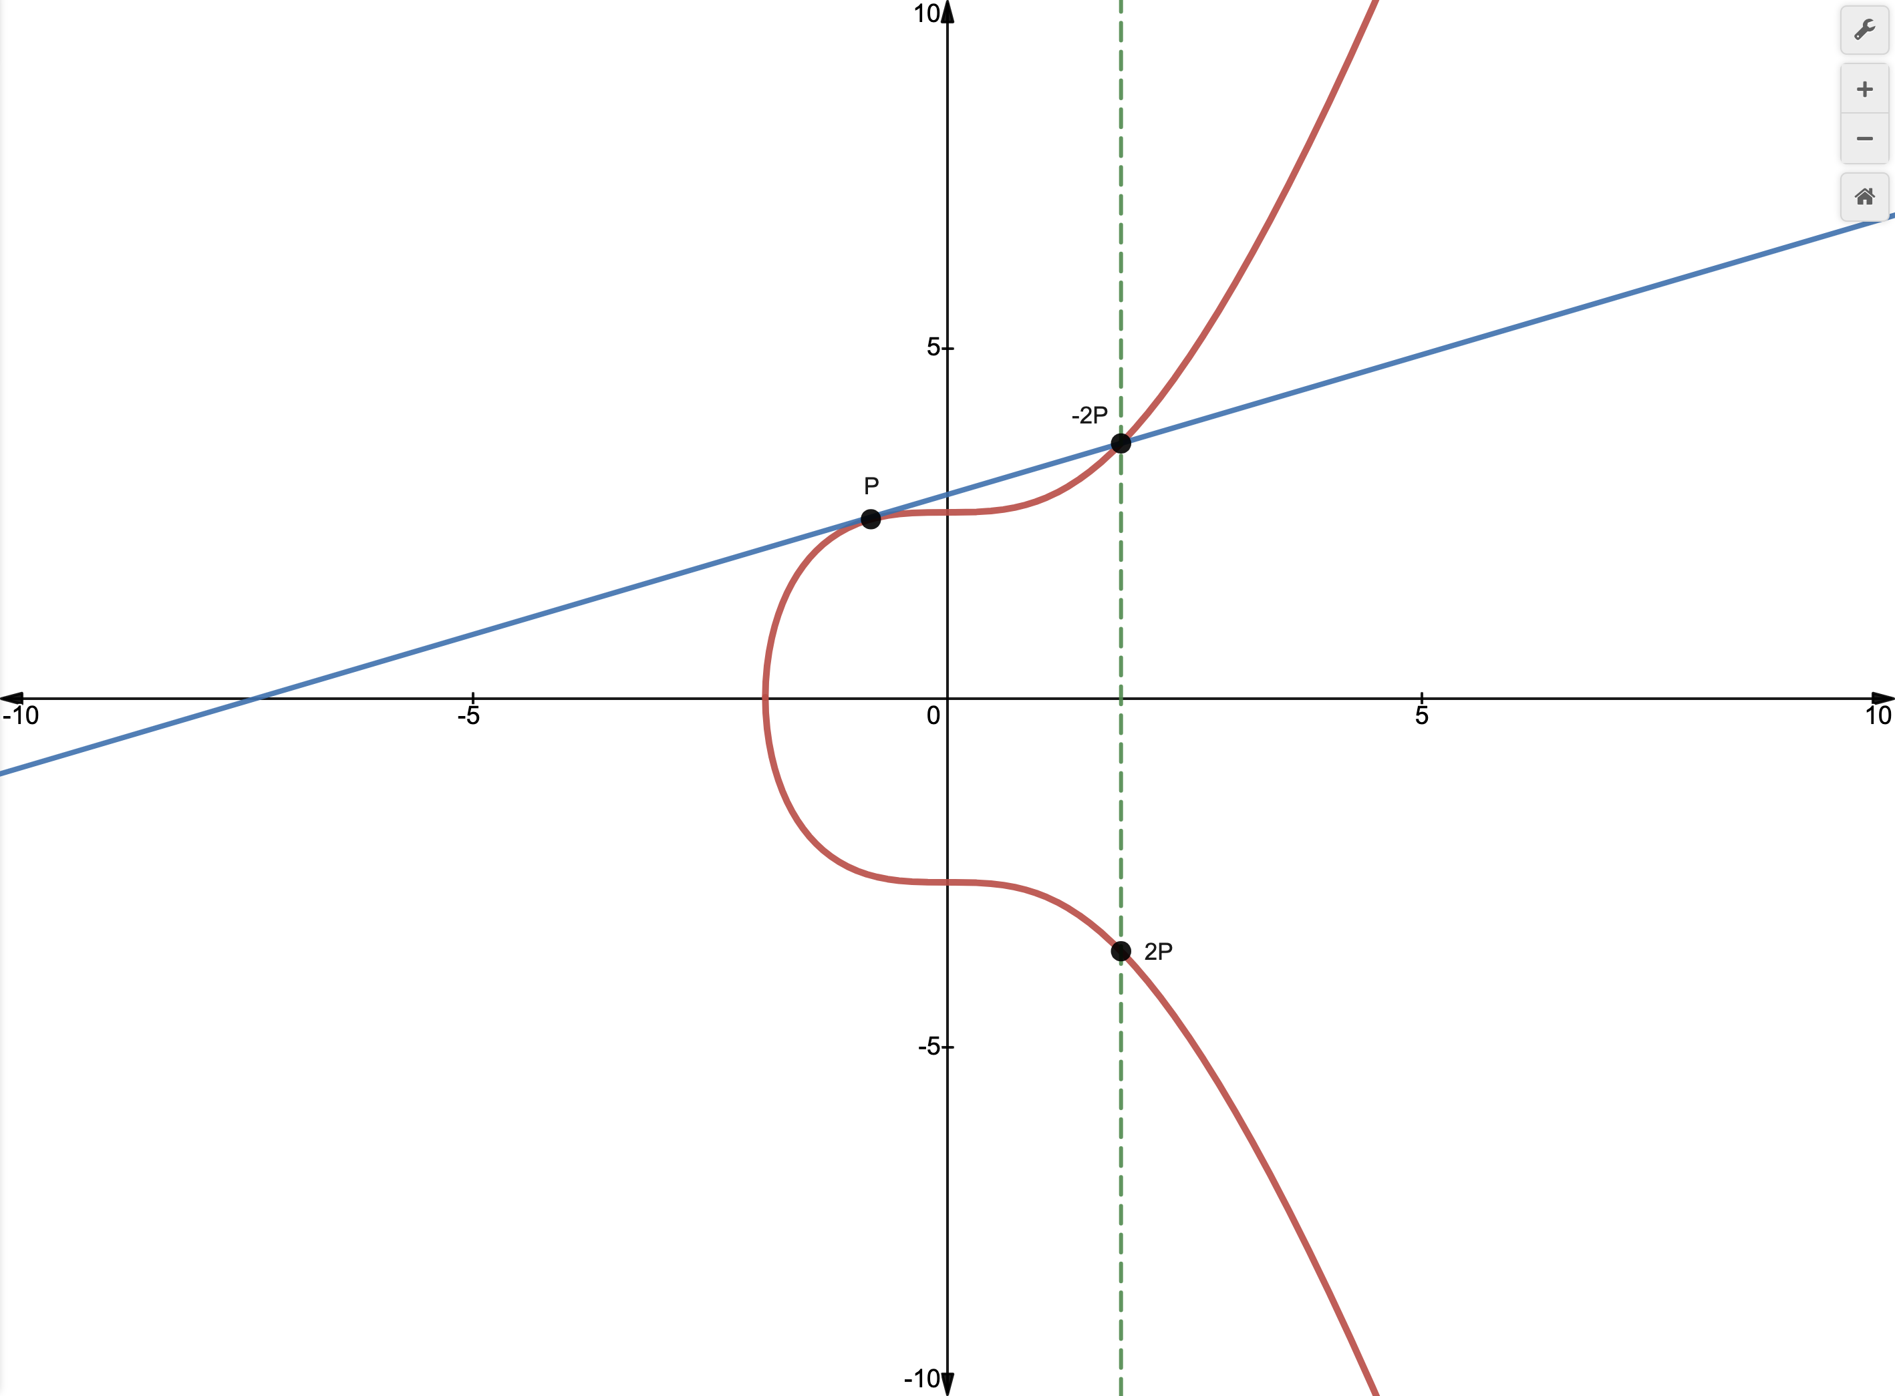
Point addition and doubling
16

Slide 17

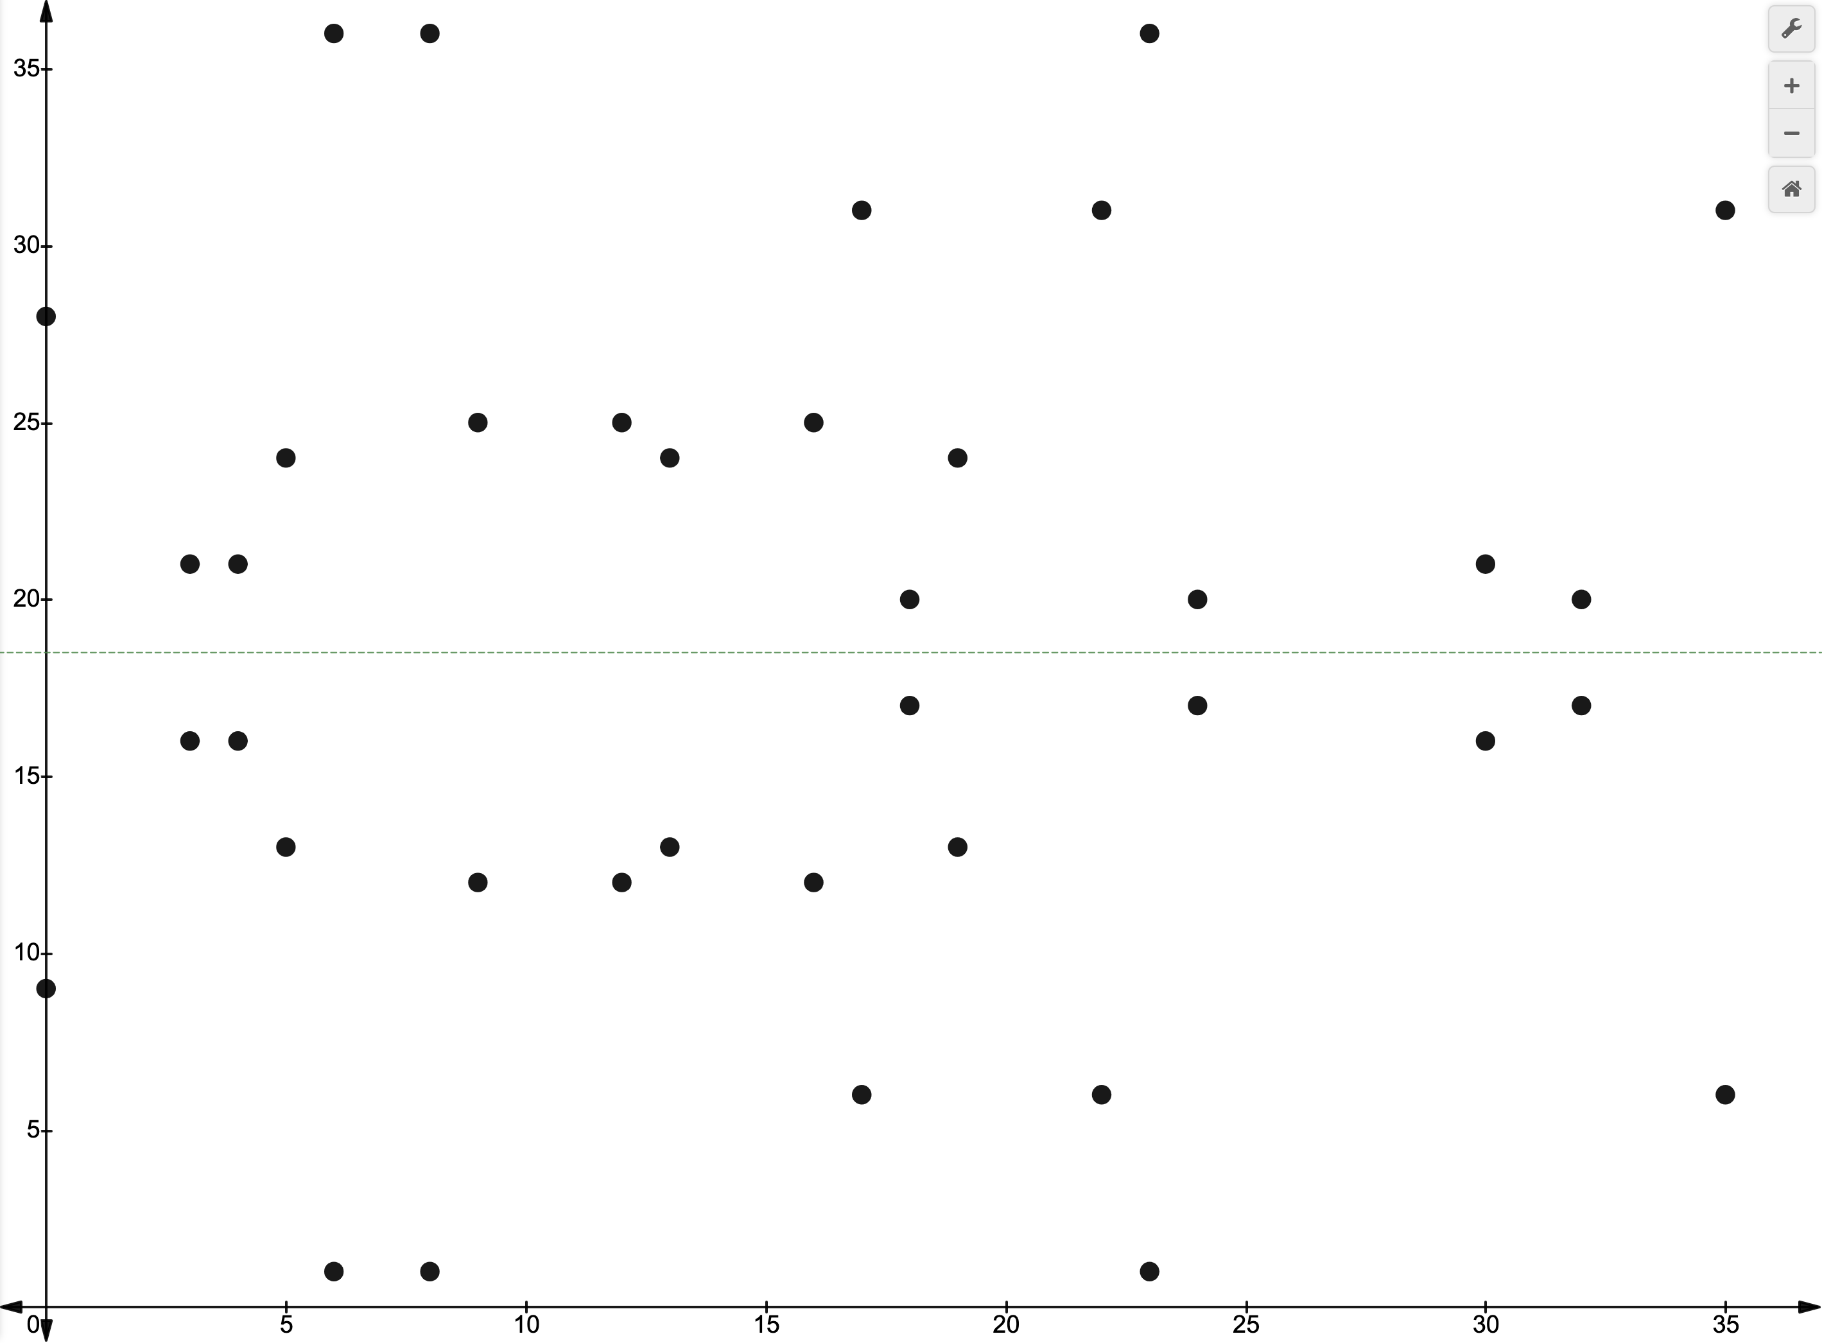
Private-Public key pair generation
17

Slide 18
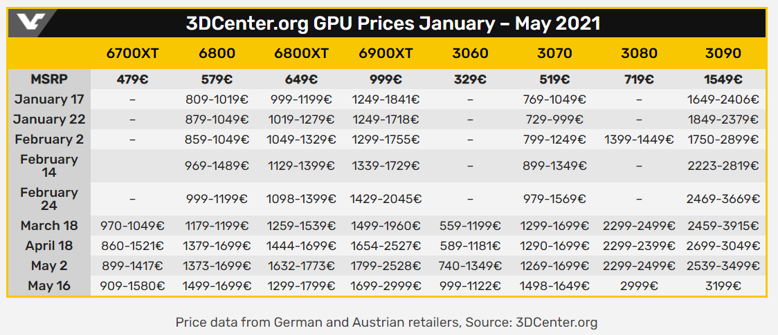
Socio-Economic Effects of Bitcoin Price increases and lack of hardware stock related to “Mining”
GPUs are one of the most important components in a mining Machine as they provide a lot of computational power and are widely used in many other industries.
To be profitable most miners use more than one GPU on their system (with Warehouses full of them at times) and try to get the more recent versions quickly but manufacturers can’t keep up with the demand and retailers take advantage and raise the prices
18

Slide 19


Socio-Economic Effects of Bitcoin Price increases and lack of hardware stock related to “Mining”
To correct the situation Manufacturers took some actions. Nvidia, one of the biggest manufacturers of GPUs, decided to create a dedicated line of GPUs optimized for Professional Mining, the NVIDIA CMP HX and reduced the mining performance of new GPUs produced from other lines by reducing the hash rate.
19

Slide 20
Socio-Economic Effects of Bitcoin Monetary system
For the time being the impact of Bitcoin on the Monetary systems is close to none.
Market capitalization (814.7 billion U.S. dollars around May 2021) is still small compared with the Market capitalization of the banking market worldwide (8.9 trillion dollars around the first Q1 of 2021).
20

Slide 21
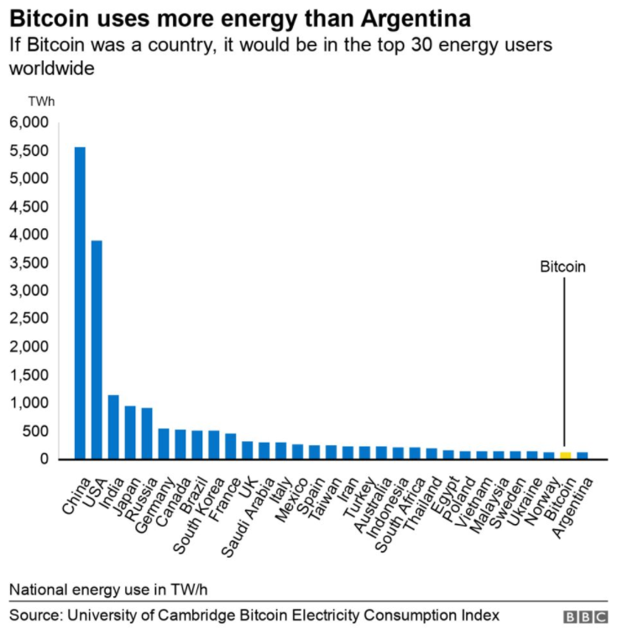
Socio-Economic Effects of Bitcoin Energy expenditure
For the mining process a large energy expenditure is necessary to support the hardware involved in the process like GPUs, which despite major advances in its electrical efficiency still have a significant energy expenditure.
Bitcoin Energy Consumption in 2019 was around 144.28 terawatt-hours (TWh), a value above many developed countries like, Sweden with 131.798 TWh, Netherlands with 110.682 TWh or Portugal with 48.0351 TWh.
21

Slide 22
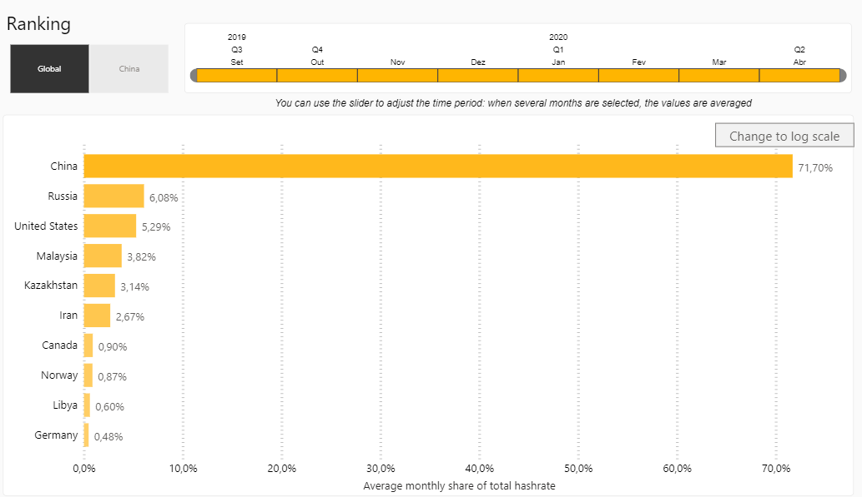
Socio-Economic Effects of Bitcoin Energy expenditure
Bitcoin Network depends heavily on coal-based power that produces some of the worst emissions, which increases Bitcoin's carbon footprint, and this makes a made a big negative impact on Bitcoin's reputation as people increasingly understand the effects of climate change and prefer solutions based mostly in green energy to those who don’t
Bitcoin Mining Graph from September 2019 to April 2020 created by the University of Cambridge
22

Slide 23
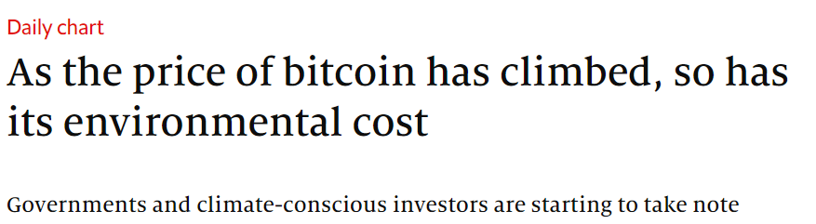
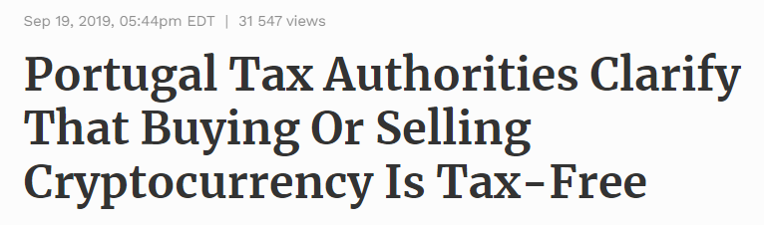
Socio-Economic Effects of Bitcoin Political implications
Some governments consider Bitcoin a menace because it doesn't have a central authority and that can destabilize or undermine the authority or control of central banks or even from the government itself
Anonymity can be used to circumvent capital controls, for money laundering or illegal purchases, and Bitcoin it’s still too risky for many investors
23

Slide 24
Conclusion
Thanks to the advanced technologies and processes Bitcoin and most cryptocurrencies use, they have characteristics very appreciated and valued nowadays, that shows potential to compete with the current monetary system, and in this way, the same already manages to have a sufficient level of support and trust from people in a way that we can’t ignore it anymore and proof of that are the socio-economic effects caused by Bitcoin that are reflected by the whole population regardless of whether or not persons have a direct connection with Bitcoin or with any cryptocurrency.
Despite these levels of trust and support Bitcoin still needs to solve many of its problems, some derived from its special characteristics to have a real, effective, and strong impact on the current monetary system.

